Slide 1

Chapter 6 Security and Reliability of Distributed Software and Systems
Lecture 24
Data Encryption, Hashing and Reliability
Text Chapter 6.3
Yinong Chen

Slide 2
Roadmap of Chapter 6
General Security & Reliability Concepts (Text Section 6.1)
IIS Roles and Windows-Based Security Mechanism
Case Study: Windows-Based Security Deployment
Forms-Based Security Creating an independent security system for Web access control and resource authorization
Web.config Support to Forms-Based Security
Access Control with Self-Registration
Error Control and Secure Socket Layer (SSL)
Data Encryption and Decryption Service
Hashing
WS Reliable Messaging

Slide 3
Secure Sockets Layer in Web Application
SSL over HTTP is the most common application of SSL: It is called HTTPS.
HTTPS encrypts the data before sending to network.
It decrypts data upon receiving data.
To apply HTTPS to your Web server,
Request/Purchase the security certificate from a certification authority; Analogy: Driver License.
Install the certificate on the server, which consists of an open key and a secret key.
The open key will be sent to the browser when connecting.
The browser uses the open key to encrypt the data and send encrypted data to the server. Server decrypts it uses the secret key

Slide 4
Need for Encryption and Decryption
We use SSL to address the problem during data transmission
In the situations where we need to store data, we need to encrypt and decrypt data of our own. For example,
Date stored: user IDs and passwords to be stored in the Web.config file, XML file, text file, or database;
Data transmitted over the internet without SSL: We cannot use remote service in this case: Data sent to the remote service is not secure;
Hashing: One way encryption, e.g., used for session ID generation
Saving sensitive data in clear text is not acceptable for an organization that cares about protecting its users, and may be liable for damage caused.

Slide 5
Encryption and Decryption Algorithms
There are many Encryption and Decryption Algorithms using the secret and public key systems: e.g., SHA-1, MD-5 used in Web.config <credential> element
Data Encryption Standard (DES), developed by IBM in 1970, was selected by the National Bureau of Standards as an official Federal Information Processing Standard (FIPS) for the United States in 1976, used for unclassified data.
It is based on a symmetric-key algorithm that uses a 56-bit key encryption. (MD-5 uses 128 bits.)
As the key length 56 is short in today’s standard, and DES is used for low-level security purpose only.
[http://en.wikipedia.org/wiki/Data_Encryption_Standard].
RSA (by Rivest, Shamir and Adleman) an open key algorithm developed in 1973, publicly known in 1977, and declassified in 1997.

Slide 6
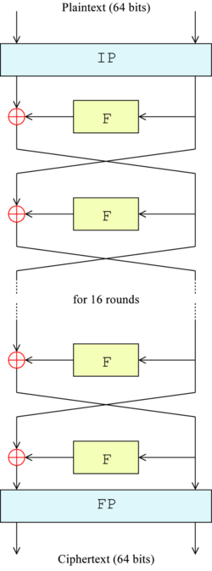
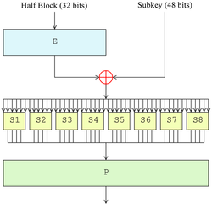
DES
http://en.wikipedia.org/wiki/Data_Encryption_Standard
Uses a secret key system
Uses block cypher encryption
Uses multiple rounds of encryptions
It is safe if the secret key does not need to be transferred to a another site.
You can use a local encryption function to encrypt data before saving into a file, and use a local decryption function to decrypt the data

Slide 7
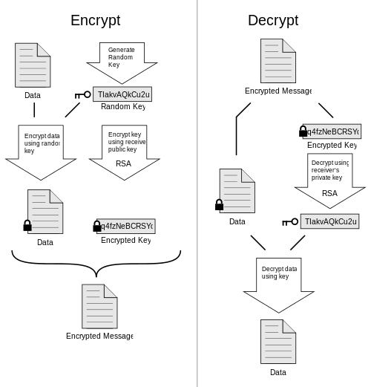
Pretty Good Privacy (PGP) Algorithm
http://en.wikipedia.org/wiki/Pretty_Good_Privacy
PGP is an open key encryption/decryption algorithm developed by Phil Zimmermann in 1991 and published in 1993 in book.
It uses multi-steps of hashing, data compression, symmetric-key cryptography, and finally public-key cryptography.

Slide 8
Legal and Ethics Cases in Data Privacy and Encryption and Decryption Algorithms
Many encryption and decryption algorithms are of matters of national security and are classified.
Encryption technologies have been used for protecting secret military and government communications.
Encryption use is entirely legal inside the U.S. borders.
Encryption algorithms are subject to strict export control to other countries, because they can be used in military applications.
Phil Zimmermann published the entire code of PGP in 1993.
He became the formal target of a criminal investigation by the US Government for "munitions export without a license", and the trial lasted for three years.

Slide 9
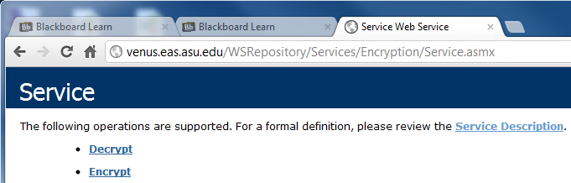
Encryption and Decryption Algorithms in .Net
.Net Framework Class Library implemented a namespace System.Security.Cryptography
It includes a number of security-related classes [http://msdn.microsoft.com/en-us/library/system.security.cryptography.aspx]
The example presented here uses the DES SymmetricAlgorithm class to create a WCF Web service with two operations:
string Encrypt(string)
string Decrypt(string)
ASU Repository:
.asmx implementation
.svc implementation

Slide 10
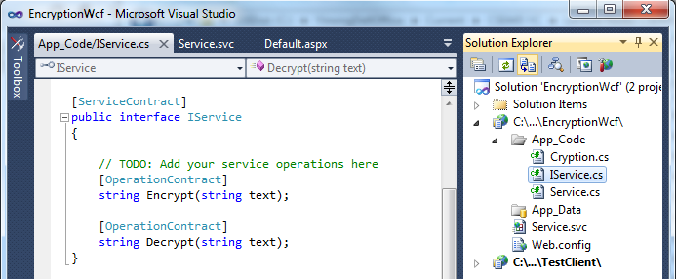
Interface Definition: Contract
File → New Web Site → WCF Service
ServiceContract and OperationContract Template are created
Enter the “Encrypt” and “Decrpyt” interface as the
[OperationContract]

Slide 11
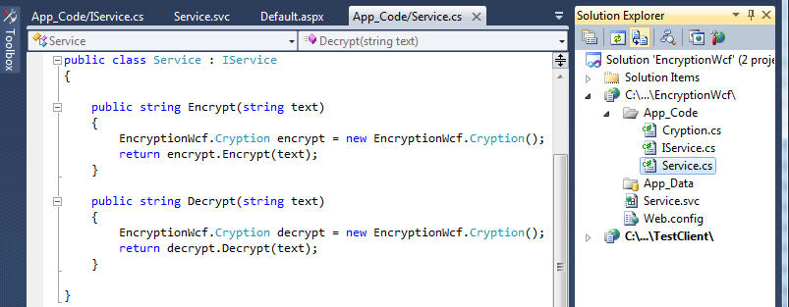
Service Implementing OperationContract

Slide 12
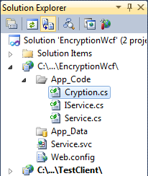
The Class Performing the Job
using System; using System.IO; using System.Text;
using System.Security.Cryptography;
namespace EncryptionWcf {
// Cryption class uses .Net Cryptography classes to perform en- and decryption
public sealed class Cryption {
byte[ ] seed = ASCIIEncoding.ASCII.GetBytes("cse44598"); // A seed from a binary array for encryption. We could encrypt the seed to make it even more secure.
public string Encrypt(string plainString) { // encryption using DES
if (String.IsNullOrEmpty(plainString)) {
throw new ArgumentNullException("The input cannot be empty or null!");
}
SymmetricAlgorithm saProvider = DES.Create();
MemoryStream mStream = new MemoryStream();
CryptoStream cStream = new CryptoStream(mStream,
saProvider.CreateEncryptor(seed, seed), CryptoStreamMode.Write);
StreamWriter sWriter = new StreamWriter(cStream);
// Continued next page

Slide 13
The Class Performing the Job (Contd.)
sWriter.Write(plainString);
sWriter.Flush(); // Buffer flush is necessary when switching writing modes
cStream.FlushFinalBlock();
return Convert.ToBase64String(mStream.GetBuffer(), 0, (int)mStream.Length);
}
public string Decrypt(string encryptedString) { // decryption using DES
if (String.IsNullOrEmpty(encryptedString)) {
throw new ArgumentNullException("The string cannot be empty or null!");
}
SymmetricAlgorithm saProvider = DES.Create();
MemoryStream memStream = new MemoryStream
(Convert.FromBase64String(encryptedString));
CryptoStream cStream = new CryptoStream(memStream,
saProvider.CreateDecryptor(seed, seed), CryptoStreamMode.Read);
StreamReader reader = new StreamReader(cStream);
return reader.ReadLine();
} } }

Slide 14
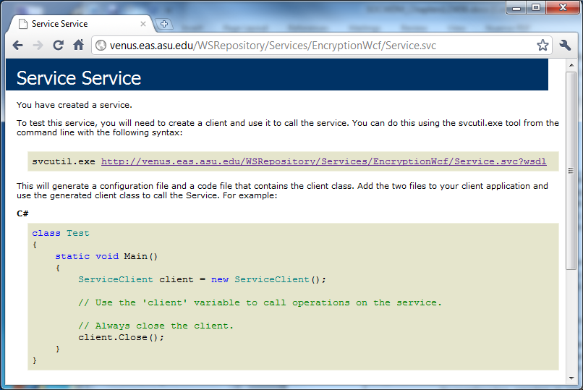
Encryption and Decryption Service Deployed
http://venus.eas.asu.edu/WSRepository/Services/EncryptionWcf/Service.svc
Can we use this service to replace SSL to save the certification cost?

Slide 15
WCF Clients
WCF is used for creating services only;
WCF services can be invoked by any service clients: Console application, ASP .Net application, Workflow application, Silverlight application, etc.
Clients connect to the WCF services through proxy:
Proxy connects to the endpoints
Proxy is generated from service contracts
Client needs to specify what endpoint to invoke for its operations
Use “Add Service Reference” to add references to WCF services, instead of using “Add Web Reference”

Slide 16
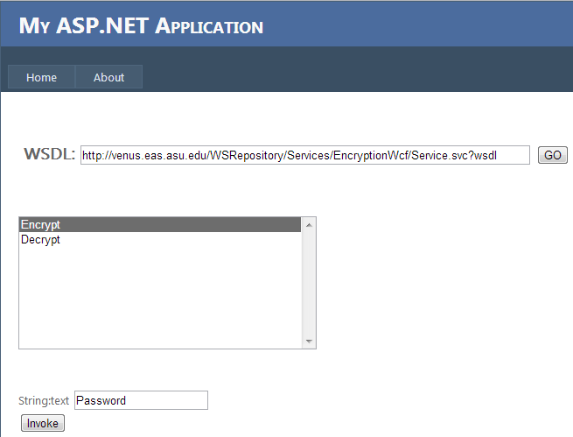
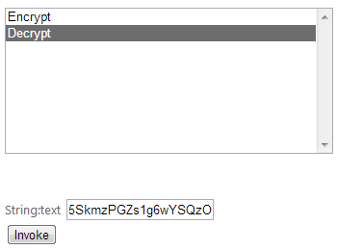
Test the Encryption and Decryption Service
5SkmzPGZs1g6wYSQzOFFfQ==
Password

Slide 17
Endpoints: A-B-C Created in the Client
<configuration>
<system.serviceModel>
<bindings>
<basicHttpBinding>
<binding name="BasicHttpBinding_IService“ >
<security mode="None">
<transport clientCredentialType="None" proxyCredentialType="None“ realm="" />
<message clientCredentialType="UserName" algorithmSuite="Default" />
</security>
</binding>
</basicHttpBinding>
</bindings>
<client>
<endpoint
address="http://venus.eas.asu.edu/WSRepository/Services/EncryptionWcf/Service.svc"
binding="basicHttpBinding" bindingConfiguration="BasicHttpBinding_IService"
contract="EncryptService.IService" name="BasicHttpBinding_IService"
</endpoint>
</client>
</system.serviceModel>
</configuration>
Endpoint: A-B-C
What other bindings available?

Slide 18
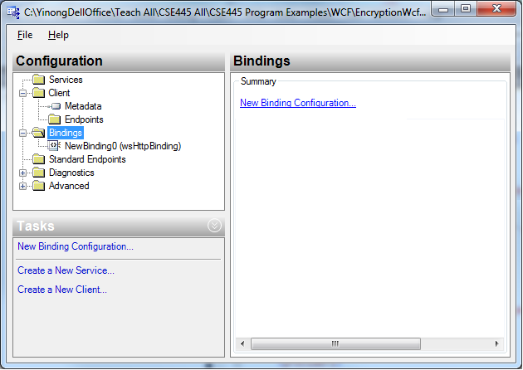
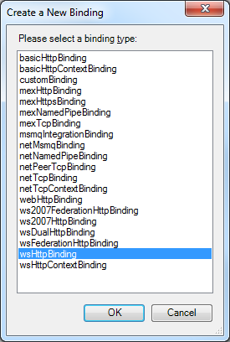
Adding a Different Binding Protocol
In VS Menu: Tools → WCF Service Configuration Editor
Browse to the application and select the Web.Config file
Implement WS-Security standard

Slide 19
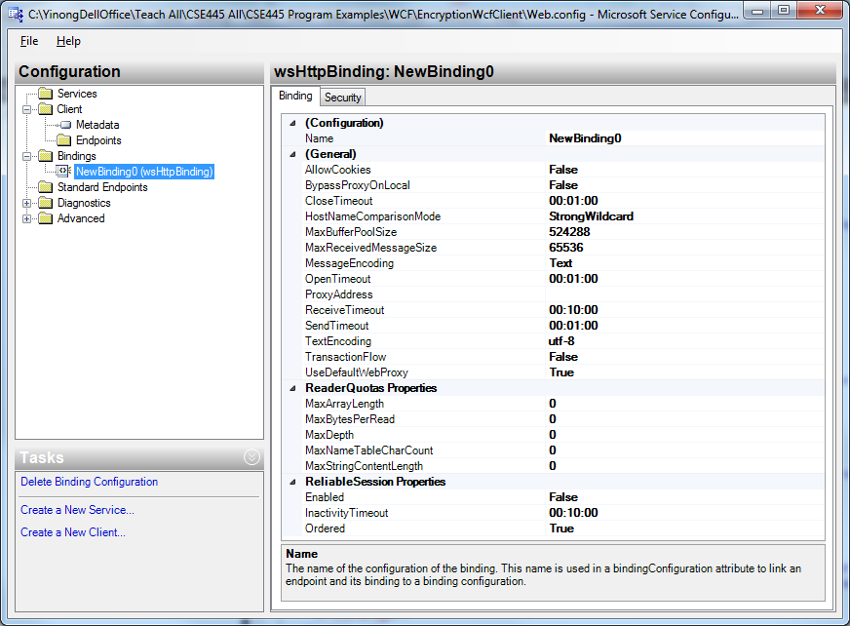
Editing the wsHttpBinding in Configuration File

Slide 20
When Should You Not Use Encryption/Decryption Web Service?
If you do not have SSL (Secure Socket Layer) protocol for Secure HTTP (HTTPS), the data sent to / from En-/Decryption Service is in clear text
You may want to create a local DLL library function in your application:
You call local encryption function before sending the data to remote server/client;
You call the decryption function after you have retrieved the encrypted data;
If receiver is different sender, both sides must install the save encryption and decryption functions.

Slide 21
Security Vulnerability Discussion
Open Key Systems generate a public key and a secrete key.
If the secrete key is intruded, the security is broken.
A vulnerability is a weakness in the system for intrusion. Without a weakness, it would take 100 years to brake in the system using systematic exploiting, such as dictionary attack.
For example, Microsoft Security Advisory (http://technet.microsoft.com/en-us/security/advisory/2416728) in 2010 acknowledged that a vulnerability was found in ASP .Net through padding oracle attacks.
Padding oracle attacks:
Generate a large number of incorrectly encrypted messages of different types and send requests for decrypting these messages;
The system (e.g. ASP .Net) sends different error messages back;
Useging the error messages types to figure out the secrete key.
If you need ultrahigh security, do not use ASP .Net crypto library. They are not design for ultrahigh security purposes. Recall that ultrahigh encryption and decryption algorithm are munitions like ABC weapons!

Slide 22
Data Hashing
When to Use Encryption and Decryption?
When to use Data Hashing?

Slide 23
Data Hashing
A hash value is a numeric value with fixed length that uniquely identifies a data, but without revealing the data’s value;
One-way feature: from data to hash value, but cannot recreate the data from the hash value;
Different from the digital signature method in Open Key system, where there are two keys and data and signature are typically mixed, and data hashing has one key to create a separate signature.
Applications:
Proof of identity: Session ID;
Separate digital signature: For a large piece of data, e.g., 100 pages of a contract, we can generate a (short) hash value1 from the contract and send the hash value1 with the contract. The receiver re-generates hash value2 from the received contract. If value1 == value2, the contract is not modified during the transmission.

Slide 24
The Best Way to Secure User’s Password
Save users’ passwords in a database (or a file). Secure the database using access control.
Save users’ passwords in a database. Make database writable, searchable, but not readable. When validating a user, search (user-name + password) in the database and it returns true or false.
Encrypt the passwords before saving into a database. Decrypt the password when validating a user.
In all solutions above, someone can see the passwords. Is there a way that no one (no hackers) can see the stored passwords?
Hash the passwords and save the hash values. When validating a user, hash the user entered password and compare it with the stored hash value.

Slide 25
Hashing for Dependable Data Storage and Communication
Used for Dependable Data Storage.
When write data
When read data
Memory / Disk
Re-create the hashing value
⊕
⊕
Create a hashing value
=?
Validate the hashing value
Hashing Value
Used for Dependable Communication.
=?
⊕
⊕
Hashing
Hashing

Slide 26
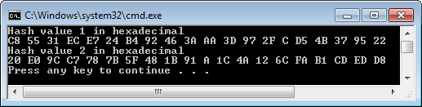
Hashing Example in Application
static void Main(string[] args) {
byte[] HashValue1; byte[] HashValue2;
string MsgShort = "You won the lottery";
string MsgLong = "This is an official announcement from the government and the message comes with a digital signature";
UnicodeEncoding Uce= new UnicodeEncoding(); // UnicodeEncoding object
byte[] BytesShort = Uce.GetBytes(MsgShort); // convert to byte array
byte[] BytesLong = Uce.GetBytes(MsgLong);
SHA1Managed SHhash = new SHA1Managed(); //Create a SHA1 object
HashValue1 = SHhash.ComputeHash(BytesShort); // Hashing
HashValue2 = SHhash.ComputeHash(BytesLong);
Console.WriteLine("Hash value 1 in hexadecimal");
foreach (byte b in HashValue1) Console.Write("{0:X} ", b);
Console.WriteLine("\nHash value 1 in hexadecimal");
foreach (byte b in HashValue2)
Console.Write("{0:X} ", b);
Console.WriteLine();
}
Short and long messages
hex
The length of 2 msgs are the same

Slide 27
Creating a Data Hashing Service
[ServiceContract]
public interface IService {
[OperationContract]
string Hash(string value, string salt);
}
using System;
using System.Text;
using System.Security.Cryptography;
using System.Text;public class Service : IService {
//Hash a value with a salt
public string Hash(string value, string salt) {
using (var sha = new SHA512CryptoServiceProvider()) {
var hashedString
= sha.ComputeHash(Encoding.Default.GetBytes(value + salt));
return Convert.ToBase64String(hashedString);
}
}
}
Test: http://venus.eas.asu.edu/WSRepository/Services/HashSha512/Service.svc

Slide 28
How can you create an efficient Digital Signature System for a Large File?
==?
Large File
Digital signature
Local Hashing
Hashing
Service
Local Hashing
?
Digital signature
Large File
Digital signature
Sending
Receiving

Slide 29

Reliable Messaging
(Text Section 6.4)

Slide 30
SOA Reliability Issues
"Web services are not yet widely used because of security concerns. But there's an even bigger roadblock waiting just down the road -- it's called trust. The big issue is "Will the service work correctly every time when I need it?" As yet few are thinking about the issues of testing and certification, we suggest that testing and certification of Web services is not business as usual and that new solutions are needed to provide assurance that services can really be trusted." -- By CBDi Forum, at <http://searchwebservices.techtarget.com/>, 11 Jul 2002.

Slide 31
Web Service Testing, as Discussed in Chapter 3
Software testing often takes more effort than software development, and thus there are huge demands on software testing professionals;
Software black-box testing vs. white-box testing
How do we do Web service testing?
Source code not available: Black-box Testing;
WSDL file is available: WSDL analysis to obtain URL, operations, input and output types;
Generate test cases: based on the input types;
Dynamically invoke the Web service;
Analyze the return values

Slide 32
WS-RM: ReliableMessaging and Others
WS-ReliableMessaging (WS-RM) deals with faults at the message level, including
Lost messages
Duplicated messages
Messages received out of order
Suitable in the scenarios where both parties are online
Message Queuing, e.g., MSMQ:
Ensure reliable communication between the sender and the receiver.
Suitable in the scenarios where the receiver may be offline
Transactions for enterprise application

Slide 33
WS-ReliableMessaging (WS-RM)
WS-RM Adoption Among Leading Vendors (Data 2007)
Company/Platform WS-RM Support
Microsoft WCF Yes
IBM, ETTK—AlphaWorks Yes
IBM WebSphere Message Q Yes
Oracle SOA Suite Yes
BEA, WebLogic 9.0 Yes
Cape Clear Yes
Systinet Yes
Blue Titan Yes
Apache Axis 1.3 Sandesha 05 Yes
SAP NetWeaver Process 07 Yes
Sonic In Development
Tibco In Development

Slide 34
WS-ReliableMessaging Features
WS-RM specification defines the following reliability features
Guaranteed message delivery, or At-Least-Once delivery semantics
Guaranteed message duplicate elimination, or At-Most-Once delivery semantics
Guaranteed message delivery and duplicate elimination, or Exactly-Once delivery semantics
Guaranteed message ordering for delivery within a group of messages

Slide 35
WS-ReliableMessaging Protocol
Endpoint B
Endpoint A
Establish Protocol Preconditions
It includes policy exchange, endpoint resolution, and establishing trust;
RM Source requests creation of a new Sequence;
RM Destination creates a new Sequence and returns its unique Identifier (ID = ABC);
RM Source transmits messages in the Sequence with MessageNumber 1.
RM Source transmits the 2nd message with MessageNumber 2, and is lost in transit;
RM Source transmits the 3rd message with MessageNumber 3,
The 1st message is acknowledged by destination;
The 3rd message is acknowledged by destination;
No acknowledgement in given time;
RM Source retransmits the 2nd message with MessageNumber 2;
The 2nd message is acknowledged by destination;
RM Source terminates the sequence ABC.
RM Source CreatesSequence
Destination CreateSequenceResponse
Sequence (ID = ABC, #1)
Sequence (ID = ABC, #2)
Sequence (ID = ABC, #3)
SequenceAcknowledgement (Identifier =1...3)
SequenceAcknowledgement (Identifier =3...3)
Sequence (ID = ABC, #2)
SequenceAcknowledgement (Identifier =2...3)
TerminateSequence (ID = ABC)

Slide 36
The Message for Creating a Sequence
<soap:body>
<wsrm:CreateSequence ...>
<wsrm:AcksTo> wsa:EndpointReferenceType </wsrm:AcksTo>
<wsrm:Expires ...> xs:duration </wsrm:Expires> ?
<wsrm:Offer ...>
<wsrm:Identifier ...> xs: http://cse445.com/ </wsrm:Identifier>
<wsrm:Endpoint> wsa:EndpointReferenceType </wsrm:Endpoint>
<wsrm:Expires ...> xs:duration </wsrm:Expires> ?
<wsrm:IncompleteSequenceBehavior>
wsrm:IncompleteSequenceBehaviorType
</wsrm:IncompleteSequenceBehavior> ?
</wsrm:Offer> ?
</wsrm:CreateSequence>
<soap:body>

Slide 37
For Message Number and Acknowledge
<soap:header>
<wsrm:sequence>
<wsrm:identifier>http://cse445.com/RM/ABC</wsrm:identifier>
<wsrm:messagenumber>1</wsrm:messagenumber>
</wsrm:sequence>
</soap:header>
<soap:header>
<wsrm:sequenceacknowledgement>
<wsrm:identifier>http://cse445.com/RM/ABC</wsrm:identifier>
<wsrm:acknowledgementrange lower="1" upper="1" />
<wsrm:acknowledgementrange lower="3" upper="3" />
</wsrm:sequenceacknowledgement>
</soap:header>

Slide 38
Reliable Messaging as a Service, e.g. ESB
Reliable Messaging Service
Client Source
Client Destination
Source endpoint
Destination Endpoint
Create msg
Send msg
Request a new sequence
Create a new sequence
Send the sequence
What do you do if this link is not reliable?
Assign
MessageSequenceNumber
What do you do if this link is not reliable?
Transmit Reliable Message
Send Acknowledgement
Deliver reliable message
Send ack
Terminate sequence request
Terminate sequence
Terminate sequence response

Slide 39
Create a Local Reliable Service
Reliable Messaging Service
Client Source
Client Destination
Source endpoint
Destination Endpoint
Create msg
Send msg
Request a new sequence
Create a new sequence
Send the sequence
Assign
MessageSequenceNumber
Transmit Reliable Message
Send Acknowledgement
Deliver reliable message
Send ack
Terminate sequence request
Terminate sequence
Terminate sequence response

Slide 40
WCF Transaction
Ensuring Data Integrity
in multiple services (or database) calls,
where some services may fail.

Slide 41
Client Initiated Transactions
WCF transactions are built on top of System.Transactions + WS-*
Initiate a transaction in client code
Transaction is flowed to all services called that support transactions: The service must support transaction.
using (TransactionScope scope = new TransactionScope())
{
// Call Service1 – transaction flowed to service1
// Call Service2 – transaction flowed to service2
scope.Complete();
} // All commit or all rollback

Slide 42
Code with More Detail
using (TransactionScope transScope = new TransactionScope()) {
// Create an connection channel
using (SqlConnection connection1 = new SqlConnection(connectString1)) {
connection1.Open(); // Opening connection1 to prepare withdrawal
connection1.BeginTransaction(IsolationLevel.Serializable);
// The connection will be listed in the TransactionScope
// Create another connection channel
using (SqlConnection connection2 = new SqlConnection(connectString2)) {
connection2.Open(); // Opening connection2 to prepare deposit
connection2.BeginTransaction(IsolationLevel.Serializable);
// The connection will be listed in the TransactionScope
}
}
// The actual method that commits the transaction.
transScope.Complete();
}
What happen if this operation fails in the way one action is completed but not the other?

Slide 43
Enabling Transactions
Transactions do not flow by default
Requirements:
Enclose service calls in transaction scope on client
Attribute transactionFlow = true on binding
[TransactionFlow] attribute on service contract methods
Optional – specify transaction scoping options
OperationBehavior attribute on service methods
TransactionFlowRequired = true
TransactionAutoComplete = true
Enable WS-Atomic Transactions on DTC (Distributed Transaction Coordinator):
xws_reg –wsat + at command line

Slide 44
Other Dependable Computing Techniques: Redundancy
N-Version Programming
2-Version Programming with recovery block
Error Control Code and Redundancy
Shannon’s Theory: Any given reliability target can be achieved, as long as sufficient redundancy is provided.

Slide 45
Summary of Chapter 6
General Security & Reliability Concepts (Text Section 6.1)
IIS Roles and Windows-Based Security Mechanism
Forms-Based Security Creating an independent security system for Web access control and resource authorization
Web.config Support to Forms-Based Security
Access Control with Self-Registration
Secure Socket Layer for Secure HTTPS Connection
Data Encryption and Decryption Service
Data Hashing and applications
Reliability: Reliable messaging and transaction

